Slide 1
Dynamical systems perspective of motor control
Shenoy, Krishna V., Maneesh Sahani, and Mark M. Churchland. ‘Cortical Control of Arm Movements: A Dynamical Systems Perspective’. Annual Review of Neuroscience 36, no. 1 (8 July 2013): 337–59. https://doi.org/10.1146/annurev-neuro-062111-150509.
Vyas, Saurabh, Matthew D. Golub, David Sussillo, and Krishna V. Shenoy. ‘Computation Through Neural Population Dynamics’. Annual Review of Neuroscience 43, no. 1 (8 July 2020): 249–75. https://doi.org/10.1146/annurev-neuro-092619-094115.
Presented by Liyuan

Slide 2
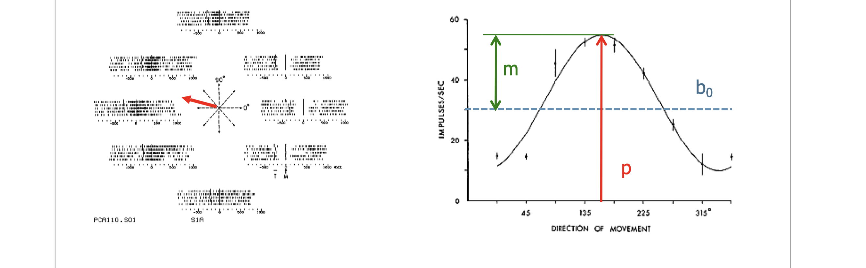
Classical view: neurons in motor cortex tuned for direction of movement

Slide 3
Classical view is limited
Fetz (1992)
over the last three decades this formula [recording single neurons in behaving animals] has generated numerous papers illustrating neurons whose activity appears to code (i.e., to covary with) various movement parameters or representations of higher-order sensorimotor functions. . . . the search for neural correlates of motor parameters may actually distract us from recognizing the operation of radically different neural mechanisms of sensorimotor control. (p. 77)
Cisek (2006)
“the role of the motor system is to produce movement, not to describe it”
Notes:
simple, view of representation of neuron
Dynamics, single neuron response is multiphasic, complex

Slide 4
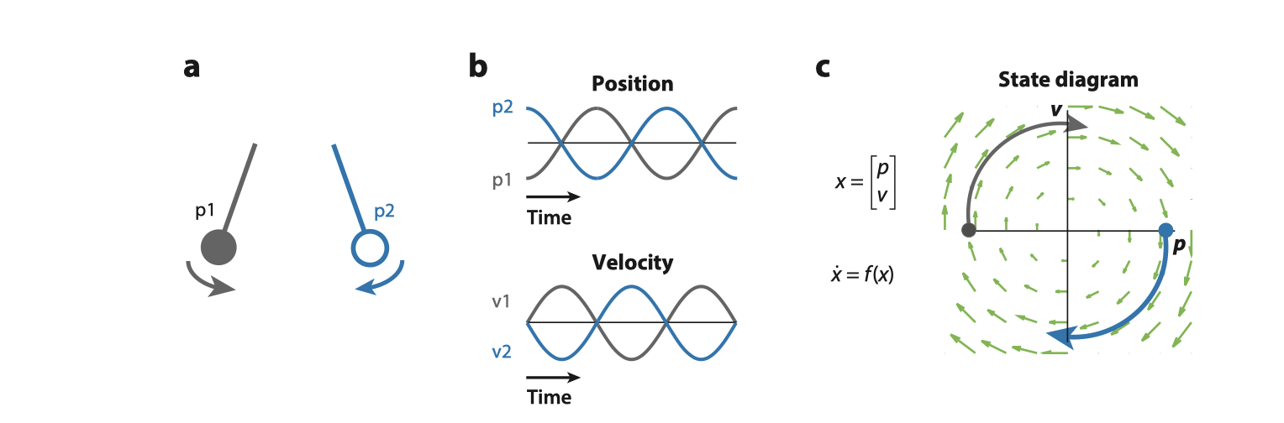
Dynamical system example: Pendulum

Slide 5
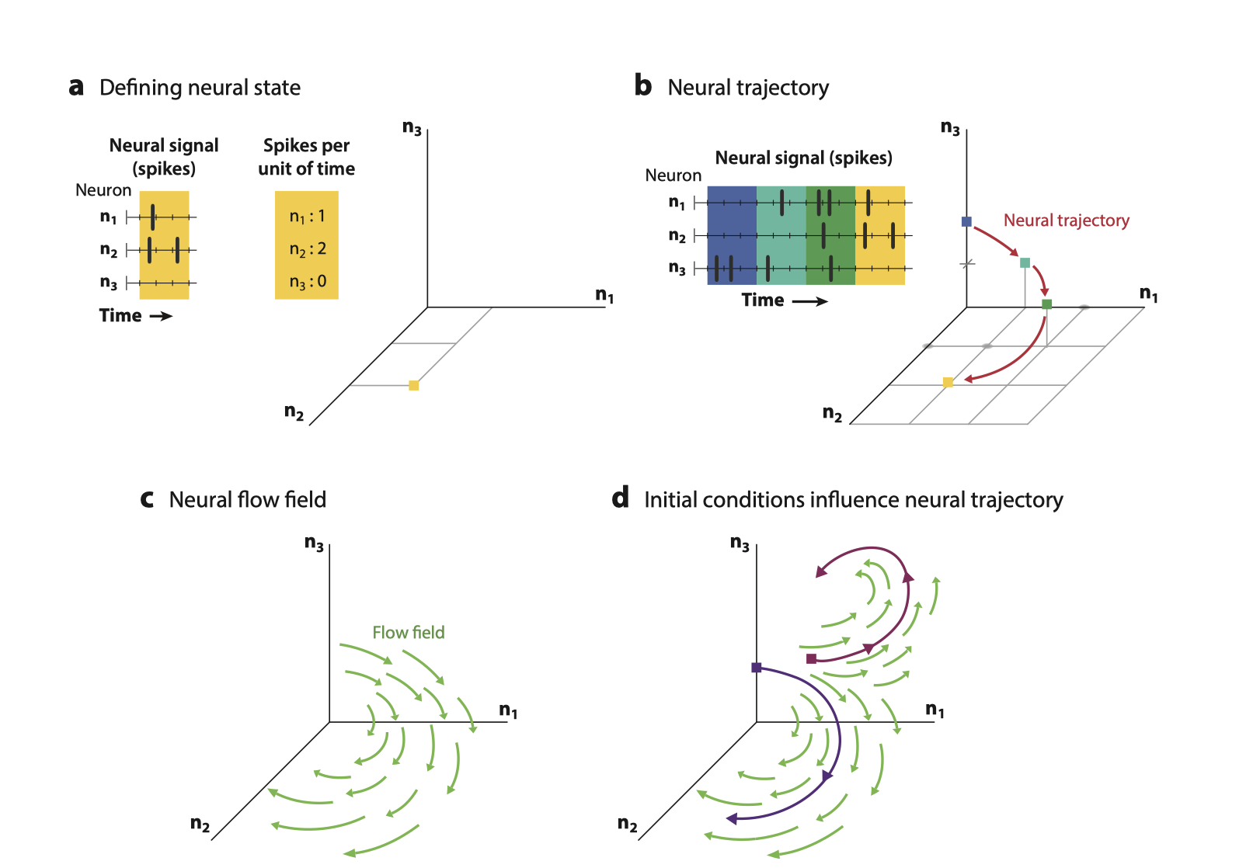
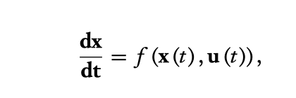
Neuron population modeled as dynamic system
extensively connected recurrent network of millions of neurons
m(t) = G[x(t)],

Slide 6
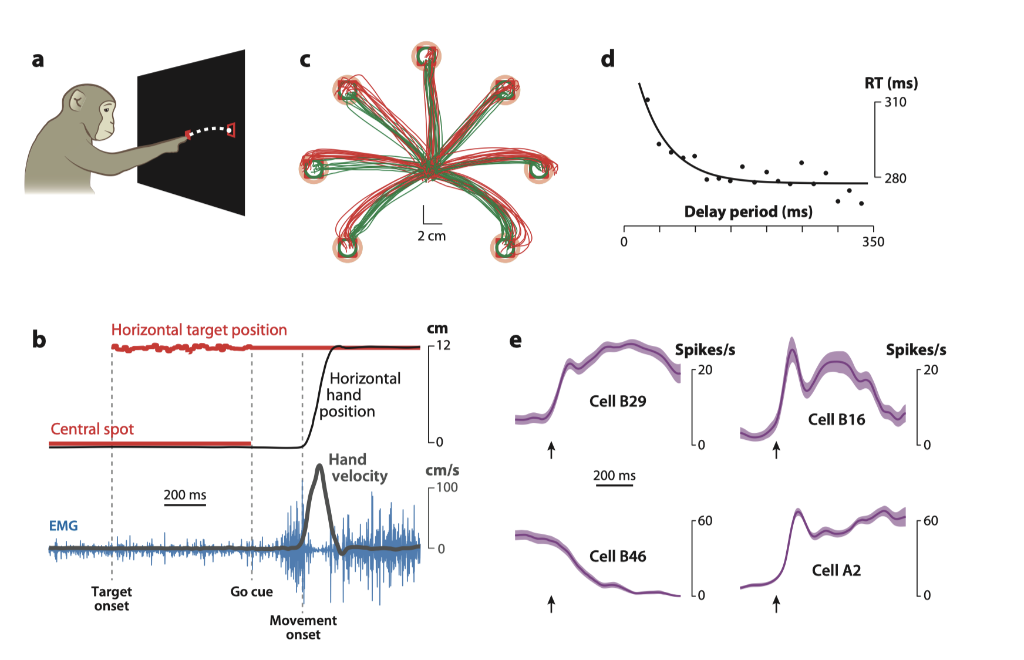
Delayed reach task: preparation phase reduces reaction time

Slide 7
Subtreshold activation vs initial condition hypothesis
Representational perspective: subthreshold activation | Dynamic systems perspective: initial condition hypothesis
Preparation activity is subthreshold activation, which allows faster RT | - Preparation activity is movement to optimal initial dynamic state - Different initial dynamic state produces different population trajectory and different movements

Slide 8
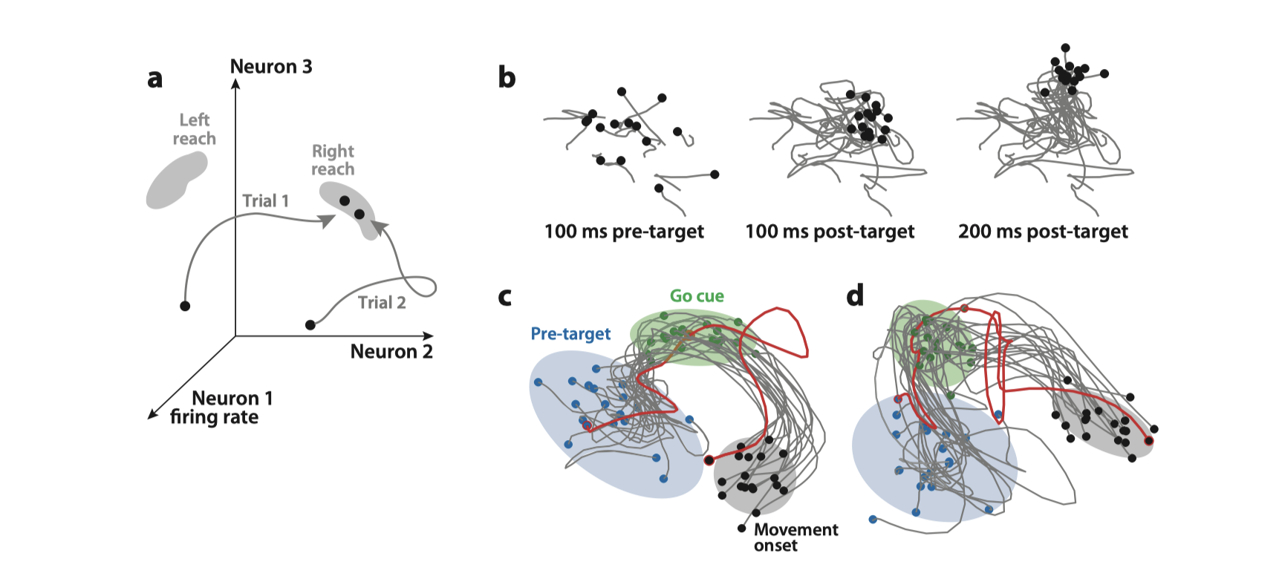
Decrease in variability sign of moving to preparation state

Slide 9
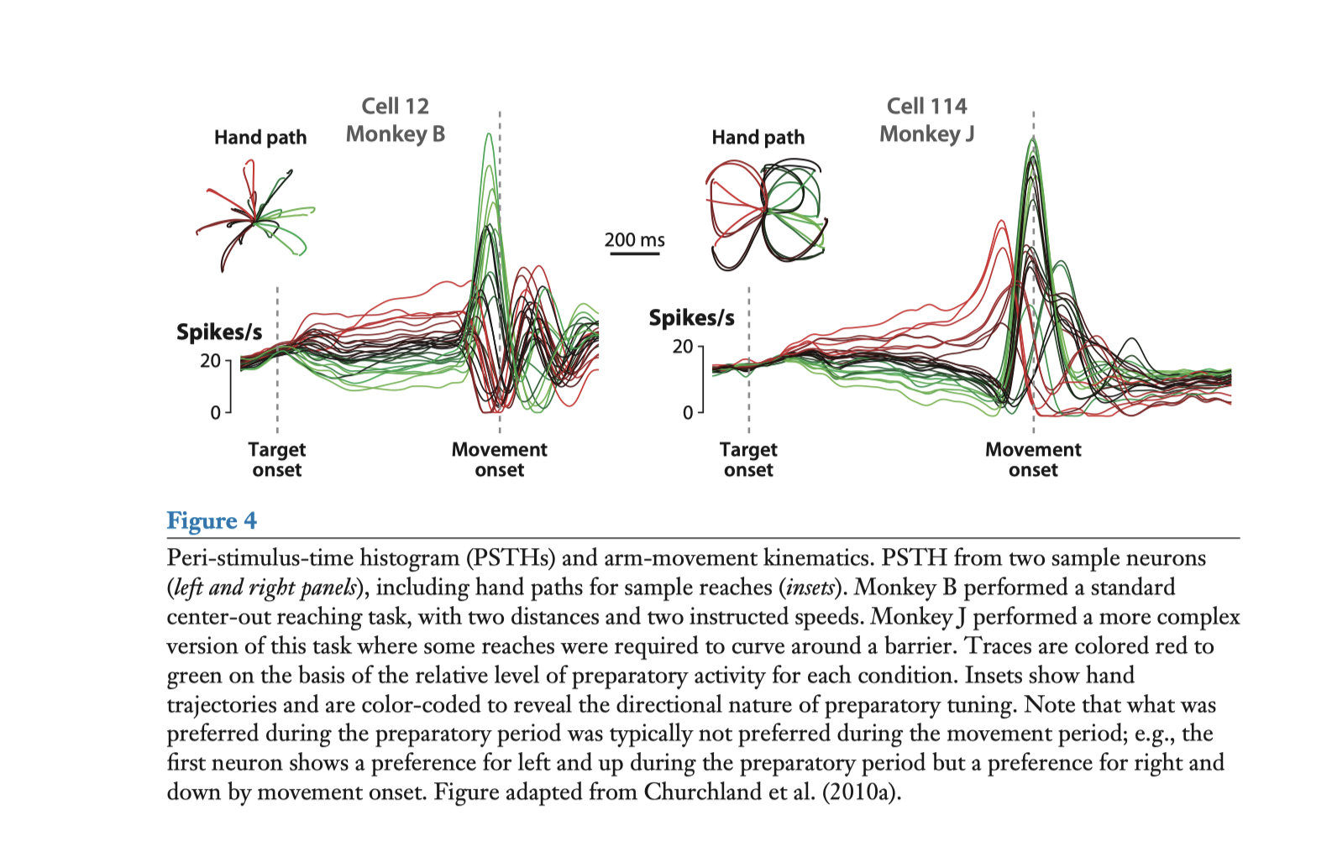
Notes:
First, the same neurons exhibit both preparatory- and movement-period activity, yet tuning during the preparatory period often differs from that during the movement period (e.g., cell 12 prefers up-left during the preparation, but down-right by movement onset) (Churchland et al. 2010a). Second, the movement-period responses are complex and multiphasic (Churchland et al. 2010a, 2012; Churchland & Shenoy 2007b). Third, the responses of different neurons are heterogeneous, even in the same animal and the same local region of the cortex (Churchland et al. 2010a, Churchland & Shenoy 2007b, Fetz 1992). In dynamical systems terms, the neural responses occupy a relatively high-dimensional space, on the order of 15–30 dimensions (Churchland & Shenoy 2007b). Thus, if neurons are to represent movement parameters, there must be
many such parameters (e.g., Pearce & Moran 2012). Finally, neural ﬁring ﬂuctuates over 400–800 ms, even when the reaches themselves are quite brief (e.g., the reaches for Monkey B lasted ∼150–300 ms). Thus if movement parameters are represented directly, there must be some unexpected temporal multiplexing (e.g., Fu et al. 1995).

Slide 10
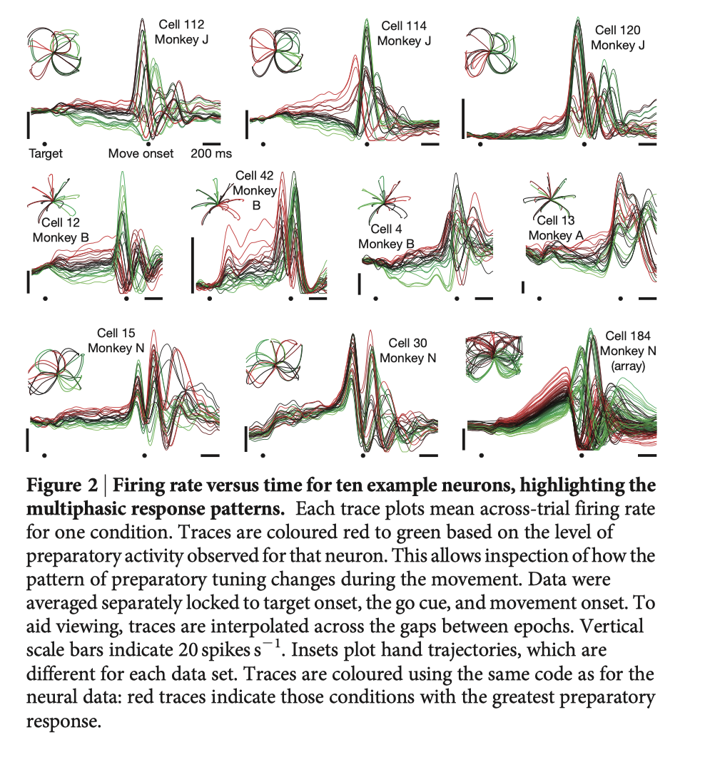

Slide 11
Evidences
Tuning during preparatory phase uncorrelated with tuning during movement
Not more inhibitory neurons activated during preparatory phase
Activity during preparation is orthogonal to dimensions that correspond to muscle activation

Slide 12
Conclusion
Larger conceptual framework for understanding functioning/dynamics of brain areas

Slide 13
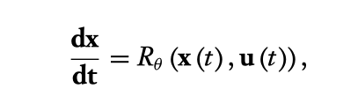
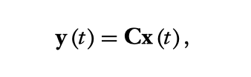
Using RNN to learn dynamical system
Data modeling
Task based modeling

Slide 14
References
Shenoy, Krishna V., Maneesh Sahani, and Mark M. Churchland. ‘Cortical Control of Arm Movements: A Dynamical Systems Perspective’. Annual Review of Neuroscience 36, no. 1 (8 July 2013): 337–59. https://doi.org/10.1146/annurev-neuro-062111-150509.
Vyas, Saurabh, Matthew D. Golub, David Sussillo, and Krishna V. Shenoy. ‘Computation Through Neural Population Dynamics’. Annual Review of Neuroscience 43, no. 1 (8 July 2020): 249–75. https://doi.org/10.1146/annurev-neuro-092619-094115.

